Slide 1
INTRODUCTION TO COMPUTING
Course Code: CCINCOM/L
Statistical Testing, Tests of Difference
Elizer Ponio Jr
Faculty
Department of Computer Science
College of Computing and Information Technologies (CCIT)
National University
Joseph Marvin R. Imperial
QUANTITATIVE METHODS
NU College of Computing and Information Technologies
Course Code: CCQUAMET

Slide 2
Statistical Inference
Learning about what we do not observe using what we observe (data).
With proper use of statistics, observations can be an educated / principled approximations. Otherwise, it’s just a wild guess.
Three Modes of Statistical Inference:
Descriptive Inference
Predictive Inference
Causal Inference
Joseph Marvin R. Imperial
QUANTITATIVE METHODS
NU College of Computing and Information Technologies
Course Code: CCQUAMET

Slide 3
Statistical Testing
The method of hypothesis testing uses tests of significance to determine the likelihood that a statement (often related to the mean or variance of a given distribution) is true, and at what likelihood we would, as statisticians, accept the statement as true.
Knowledge of how to appropriately use each test (and when to use which test) is equally important.
Joseph Marvin R. Imperial
QUANTITATIVE METHODS
NU College of Computing and Information Technologies
Course Code: CCQUAMET

Slide 4
Statistical Testing
Research question: Exploring a comparison, association or relationship
Level of measurement of data: Categorical or scale (continuous)
From your research question you should formulate one or more hypotheses each leading to two possible outcomes:
Null Hypothesis (H₀): Assumes no difference, association or relationship between the variables
Alternative Hypothesis (H_{A}): Assumes a difference, association or relationship between the variables
The use of an appropriate statistical hypothesis test will allow you to decide between these two outcomes by examining the probability (or p) value of the test statistic.
Joseph Marvin R. Imperial
QUANTITATIVE METHODS
NU College of Computing and Information Technologies
Course Code: CCQUAMET

Slide 5
p-value
A decision between the two hypotheses is made by viewing the p-value, which is the probability or chance of a more extreme event happening under the assumption of the null hypothesis.
If this probability is small, H₀ is rejected in favor of H_{A}, which is termed a statistically significant result.
Otherwise we 'fail to reject H₀', which is termed a non-statistically significant result.
Joseph Marvin R. Imperial
QUANTITATIVE METHODS
NU College of Computing and Information Technologies
Course Code: CCQUAMET

Slide 6
significance
Significance, or statistical significance, describes a decision made concerning a value stated in the null hypothesis. When the null hypothesis is rejected, we reach significance. When the null hypothesis is retained, we fail to reach significance.
The decision to reject or retain the null hypothesis is called significance.
Joseph Marvin R. Imperial
QUANTITATIVE METHODS
NU College of Computing and Information Technologies
Course Code: CCQUAMET

Slide 7
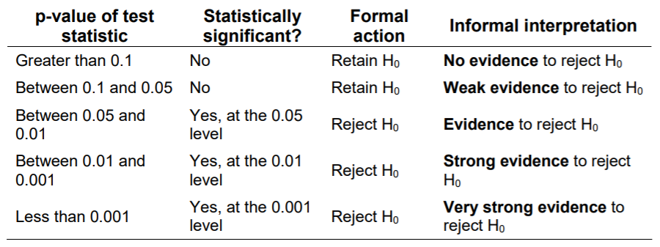
You should always relate back the outcome of the hypothesis testing to particular variables in your study; don't just conclude with 'reject the null hypothesis’.
You will need to discuss your results and conclusions in the context of the work of others, and the potential for further studies. Note that statistical significance does not necessarily indicate practical usefulness of a result.
Joseph Marvin R. Imperial
QUANTITATIVE METHODS
NU College of Computing and Information Technologies
Course Code: CCQUAMET

Slide 8
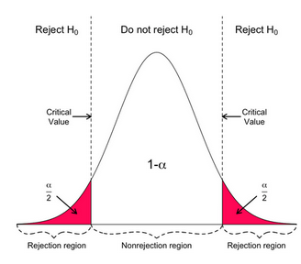
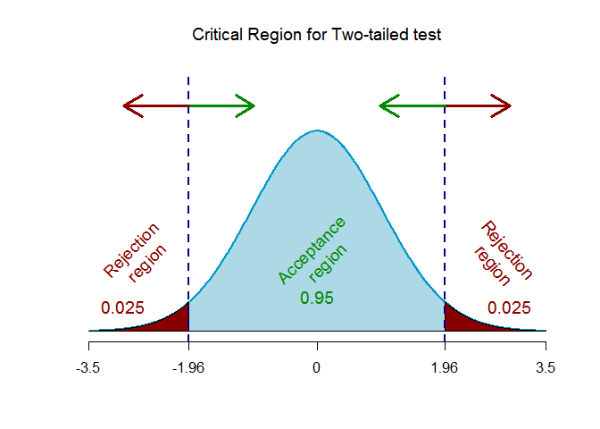
Joseph Marvin R. Imperial
QUANTITATIVE METHODS
NU College of Computing and Information Technologies
Course Code: CCQUAMET

Slide 9
Steps to Hypothesis Testing
Step 1: State the hypotheses.
Step 2: Set the criteria for a decision.
Step 3: Compute the test statistic.
Step 4: Make a decision.
Joseph Marvin R. Imperial
QUANTITATIVE METHODS
NU College of Computing and Information Technologies
Course Code: CCQUAMET

Slide 10
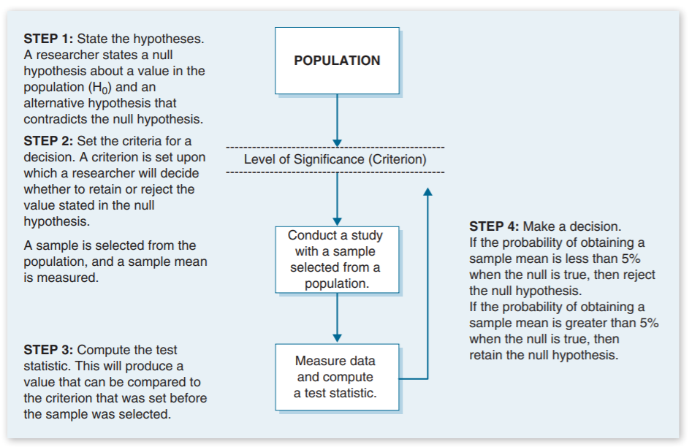
Joseph Marvin R. Imperial
QUANTITATIVE METHODS
NU College of Computing and Information Technologies
Course Code: CCQUAMET

Slide 11
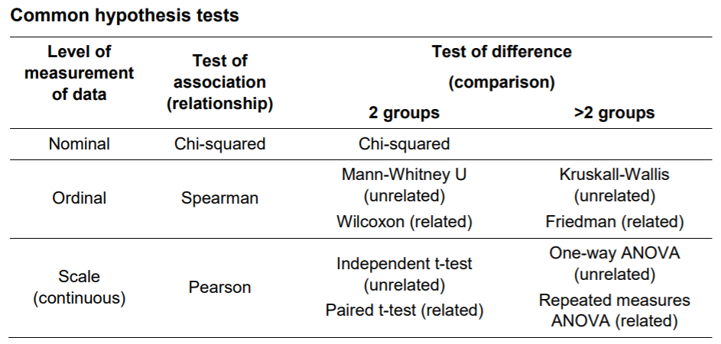
Joseph Marvin R. Imperial
QUANTITATIVE METHODS
NU College of Computing and Information Technologies
Course Code: CCQUAMET

Slide 12
Limitations
For your project, you may be restricted in the data you are able to collect. For example, you may not have a true 'random sample', but rather a 'convenience' sample.
Always try to get as representative a sample as possible, but you may only be able to obtain a relatively small number of cases (e.g. less than 30). This may affect the results of statistical testing.
Another influence on outcomes is underlying assumptions necessary for the validity of the tests. Sometimes, data are assumed to be representative of the population from which they have been drawn and come from a normal distribution.
Joseph Marvin R. Imperial
QUANTITATIVE METHODS
NU College of Computing and Information Technologies
Course Code: CCQUAMET

Slide 13
Two Sample t test for Comparing Two Means
The two-sample t-test (also known as the independent samples t-test) is a method used to test whether the unknown means of two groups are equal or not.
Determines whether there is statistical evidence that the associated population means are significantly different. The independent samples t-test is a parametric test.
Joseph Marvin R. Imperial
QUANTITATIVE METHODS
NU College of Computing and Information Technologies
Course Code: CCQUAMET

Slide 14
Examples
The independent samples t-test is commonly used to test the following:
Statistical differences between the means of two groups
Statistical differences between the means of two interventions
Statistical differences between the means of two change scores
Joseph Marvin R. Imperial
QUANTITATIVE METHODS
NU College of Computing and Information Technologies
Course Code: CCQUAMET

Slide 15
Assumptions
The sampling method for each sample is simple random sampling.
The samples are independent.
There is no relationship between the subjects in each sample. This means that:
Subjects in the first group cannot also be in the second group
No subject in either group can influence subjects in the other group
No group can influence the other group
Normal distribution (approximately) of the dependent variable for each group.
No outliers.
Joseph Marvin R. Imperial
QUANTITATIVE METHODS
NU College of Computing and Information Technologies
Course Code: CCQUAMET

Slide 16
t distribution
The t-distribution describes the standardized distances of sample means to the population mean when the population standard deviation σ is not known, and the observations come from a normally distributed population.
The standard normal or z-distribution assumes that you know the population standard deviation. The t-distribution is based on the sample standard deviation.
Joseph Marvin R. Imperial
QUANTITATIVE METHODS
NU College of Computing and Information Technologies
Course Code: CCQUAMET

Slide 17
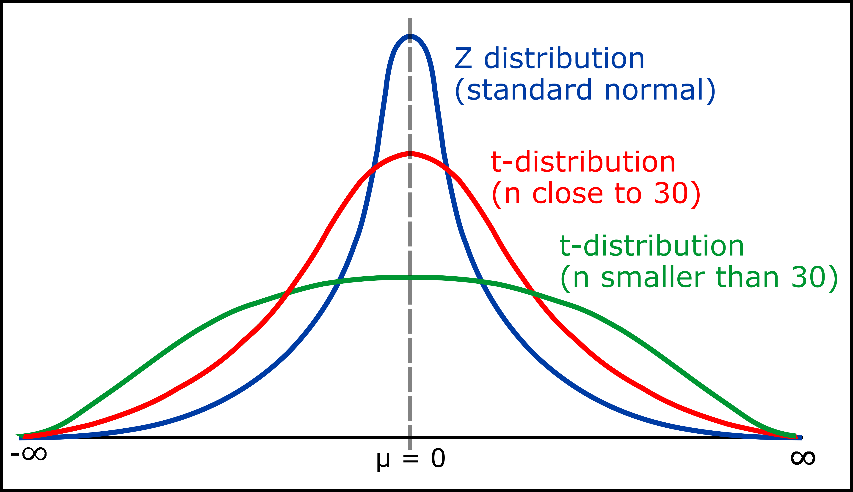
t distribution
Joseph Marvin R. Imperial
QUANTITATIVE METHODS
NU College of Computing and Information Technologies
Course Code: CCQUAMET

Slide 18
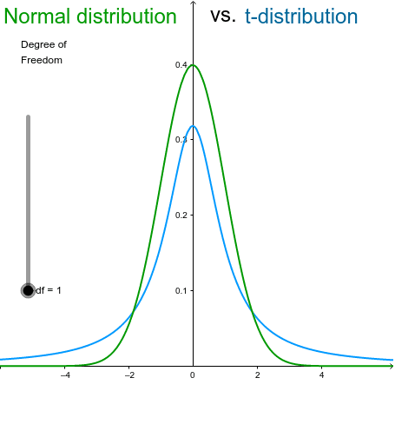
t distribution
Joseph Marvin R. Imperial
QUANTITATIVE METHODS
NU College of Computing and Information Technologies
Course Code: CCQUAMET

Slide 19
t distribution vs. normal distribution
Like the normal distribution, the t-distribution has a smooth shape, is symmetric, and has a mean of zero.
The normal distribution assumes that the population standard deviation is known. The t-distribution does not make this assumption.
The t-distribution is defined by the degrees of freedom. These are related to the sample size. The curves with more degrees of freedom are taller and have thinner tails.
The t-distribution is most useful for small sample sizes, when the population standard deviation is not known, or both.
As the sample size increases, the t-distribution becomes more similar to a normal distribution.
Joseph Marvin R. Imperial
QUANTITATIVE METHODS
NU College of Computing and Information Technologies
Course Code: CCQUAMET

Slide 20
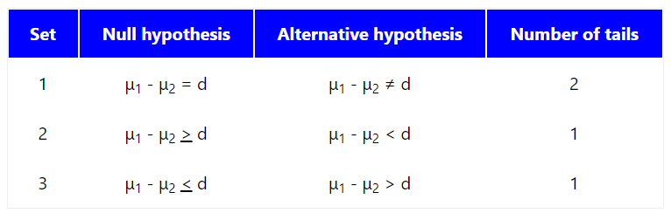
Hypothesis
Every hypothesis test requires the analyst to state a null hypothesis and an alternative hypothesis. The hypotheses are stated in such a way that they are mutually exclusive. That is, if one is true, the other must be false; and vice versa.
Joseph Marvin R. Imperial
QUANTITATIVE METHODS
NU College of Computing and Information Technologies
Course Code: CCQUAMET

Slide 21
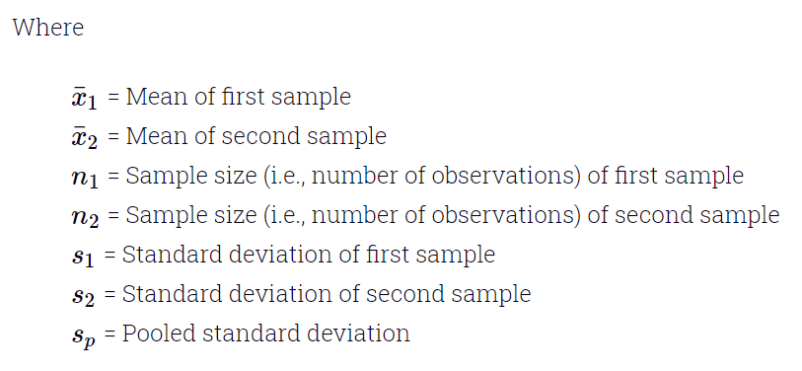
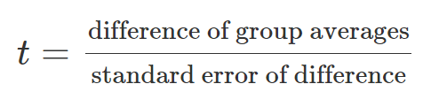
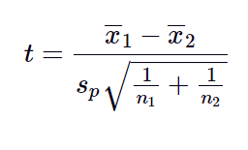
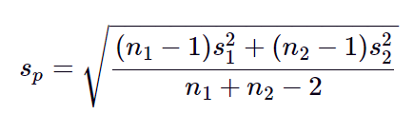
Test Statistic t (Equal Variances)
There are actually two forms of the test statistic for this test, depending on whether or not equal variances are assumed.
Equal Variances:
Joseph Marvin R. Imperial
QUANTITATIVE METHODS
NU College of Computing and Information Technologies
Course Code: CCQUAMET

Slide 22
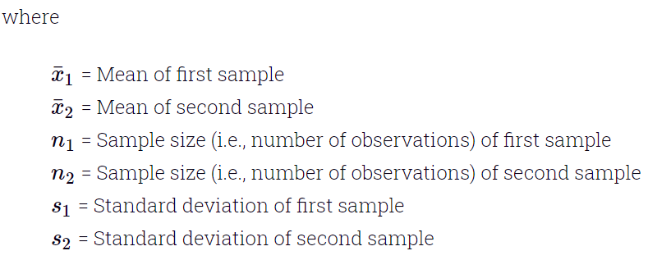
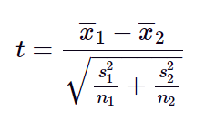
Test Statistic t (Unequal Variances)
When the two independent samples are assumed to be drawn from populations with unequal variances (i.e., σ12 ≠ σ22), the test statistic t is computed as:
Unequal Variances:
Joseph Marvin R. Imperial
QUANTITATIVE METHODS
NU College of Computing and Information Technologies
Course Code: CCQUAMET

Slide 23
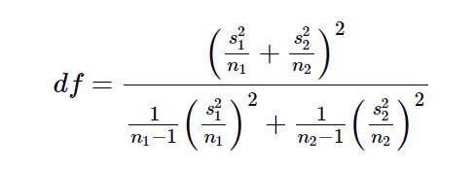
Compare t statistic with critical t value
The calculated t value is then compared to the critical t value from the t distribution table with degrees of freedom. Degrees of freedom are the number of independent values that a statistical analysis can estimate.
If the calculated t statistic > critical t value from t table, then we reject the null hypothesis.
Joseph Marvin R. Imperial
QUANTITATIVE METHODS
NU College of Computing and Information Technologies
Course Code: CCQUAMET

Slide 24
t table
http://www.math.odu.edu/stat130/t-tables.pdf
Joseph Marvin R. Imperial
QUANTITATIVE METHODS
NU College of Computing and Information Technologies
Course Code: CCQUAMET

Slide 25
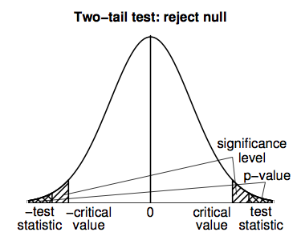
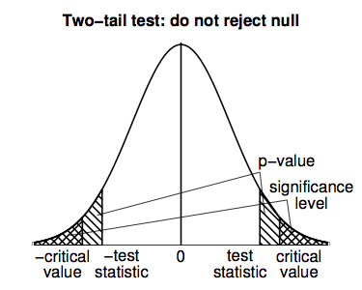
When will I reject the null?
Joseph Marvin R. Imperial
QUANTITATIVE METHODS
NU College of Computing and Information Technologies
Course Code: CCQUAMET

Slide 26
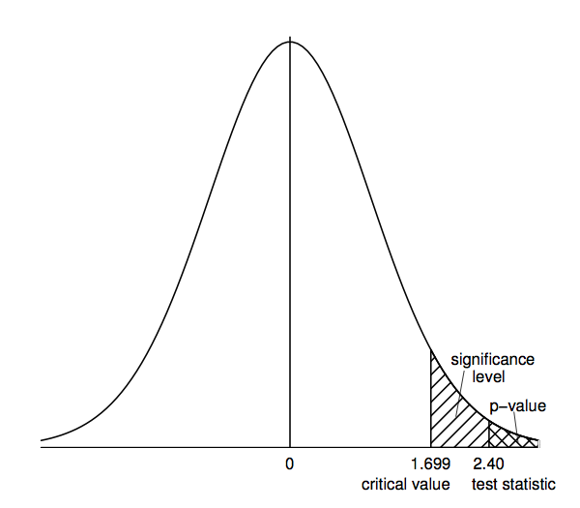
Joseph Marvin R. Imperial
QUANTITATIVE METHODS
NU College of Computing and Information Technologies
Course Code: CCQUAMET

Slide 27
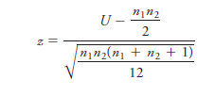
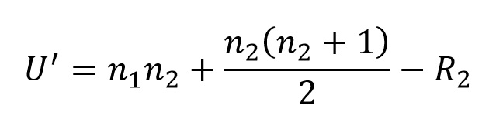
Mann-Whitney U Test
The Mann-Whitney U test is a non-parametric test that can be used in place of an unpaired t-test. Transforms and ranks values before computing the test statistic U.
It is used to test the null hypothesis that two samples whether observations in one sample tend to be larger (or different) than observations in the other.
Joseph Marvin R. Imperial
QUANTITATIVE METHODS
NU College of Computing and Information Technologies
Course Code: CCQUAMET

Slide 28
Mann-Whitney U Test Assumptions
The Mann Whitney U-Test is used when the requirements of the t-test are not met.
The sample drawn from the population is random.
Independence within the samples and mutual independence is assumed.
Ordinal or continuous measurement scale is assumed.
Joseph Marvin R. Imperial
QUANTITATIVE METHODS
NU College of Computing and Information Technologies
Course Code: CCQUAMET

Slide 29
Mann-Whitney U Table of Critical Values
http://ocw.umb.edu/psychology/psych-270/other-materials/RelativeResourceManager.pdf
Joseph Marvin R. Imperial
QUANTITATIVE METHODS
NU College of Computing and Information Technologies
Course Code: CCQUAMET

